Slide 1
RL seminar
Boyeon, Kim
23.10.19

Slide 2
Done List
SLIAR
Learning rate
Local maximum check
Solution reward vs. shifting solution reward
Change the reward design
Add the weight term
Penalty term check

Slide 3
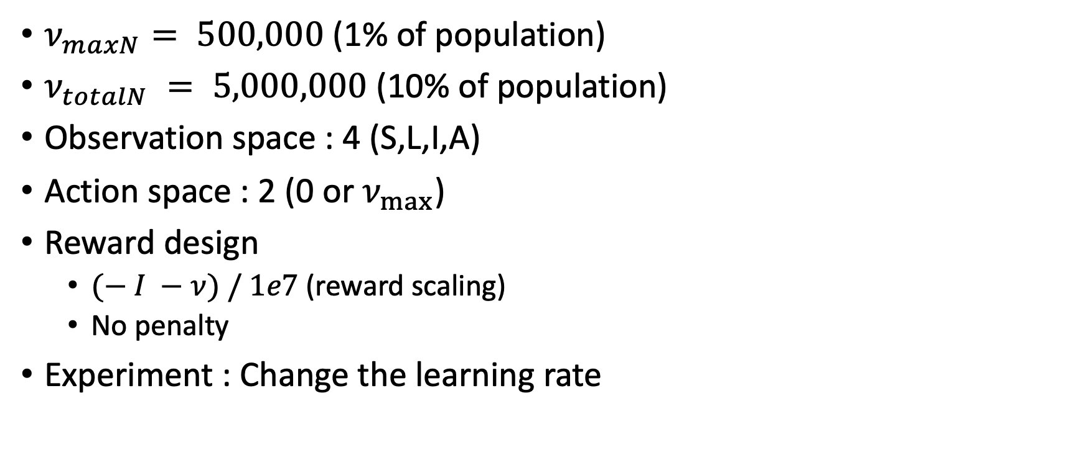
Set the environment for DQN in SLIAR
$ν_{maxN}⁡= 500,000$ (1% of population)
$ν_{totalN} = 5,000,000$ (10% of population)
Observation space : 4 (S,L,I,A)
Action space : 2 (0 or $ν_{max}$)
Reward design
$(− I −ν) / 1e7$(reward scaling)
No penalty
Experiment : Change the learning rate

Slide 4
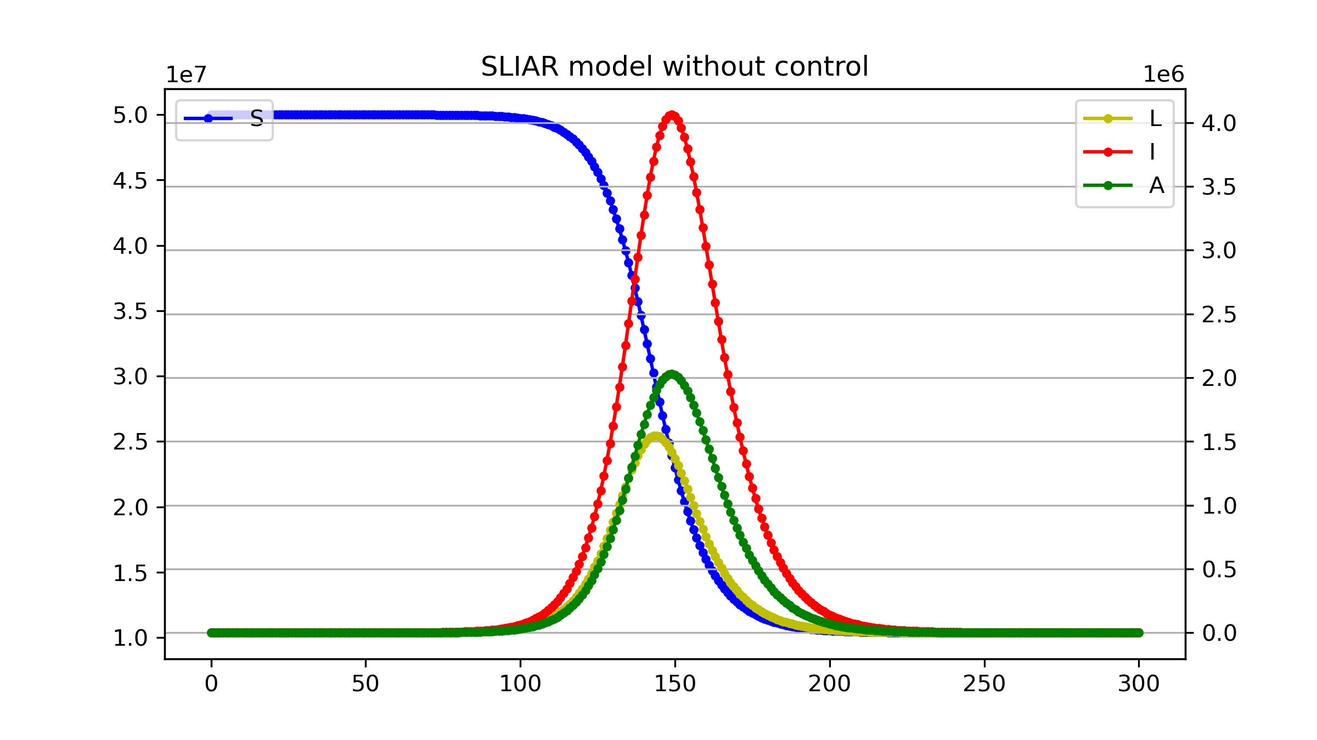
Result w/o control

Slide 5
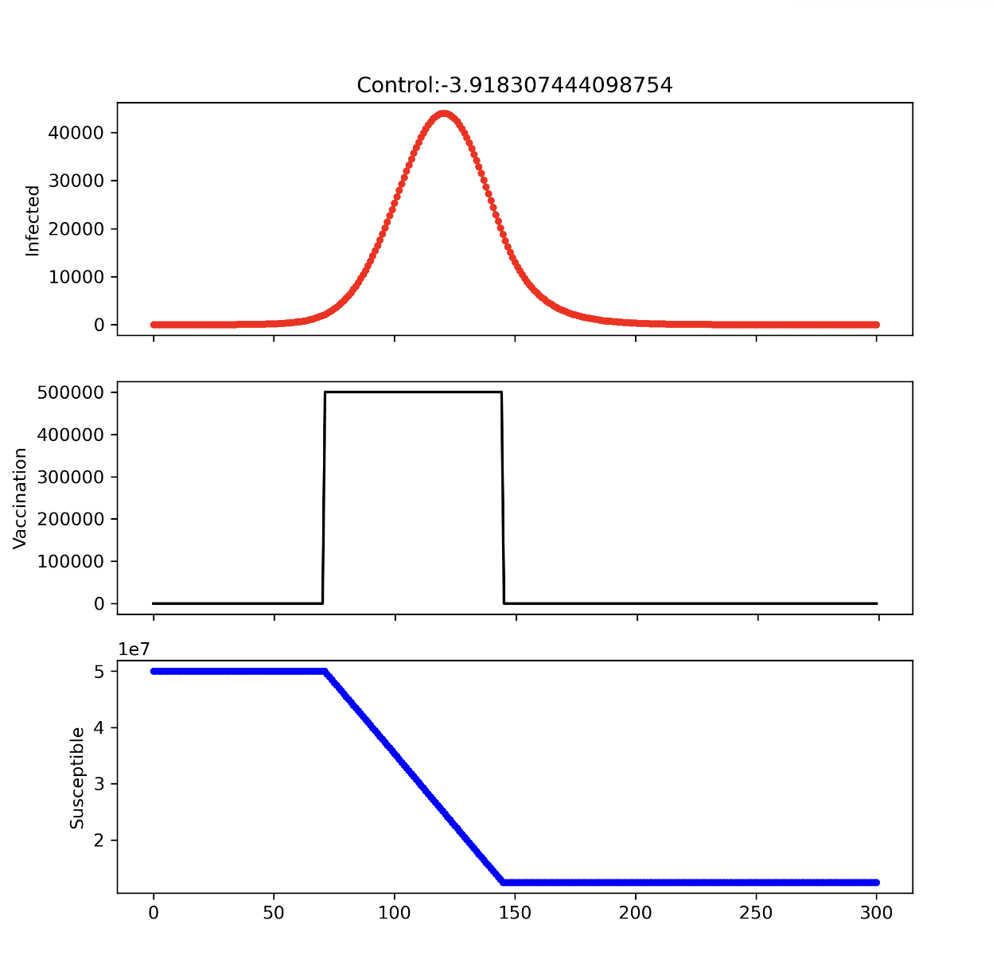
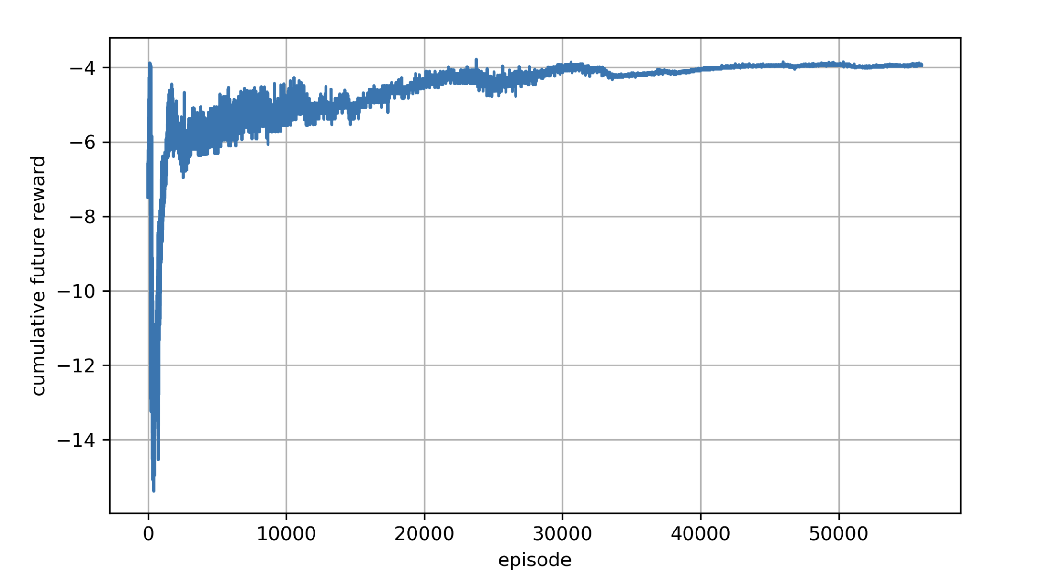
Learning rate : 1e-4
Previous result

Slide 6
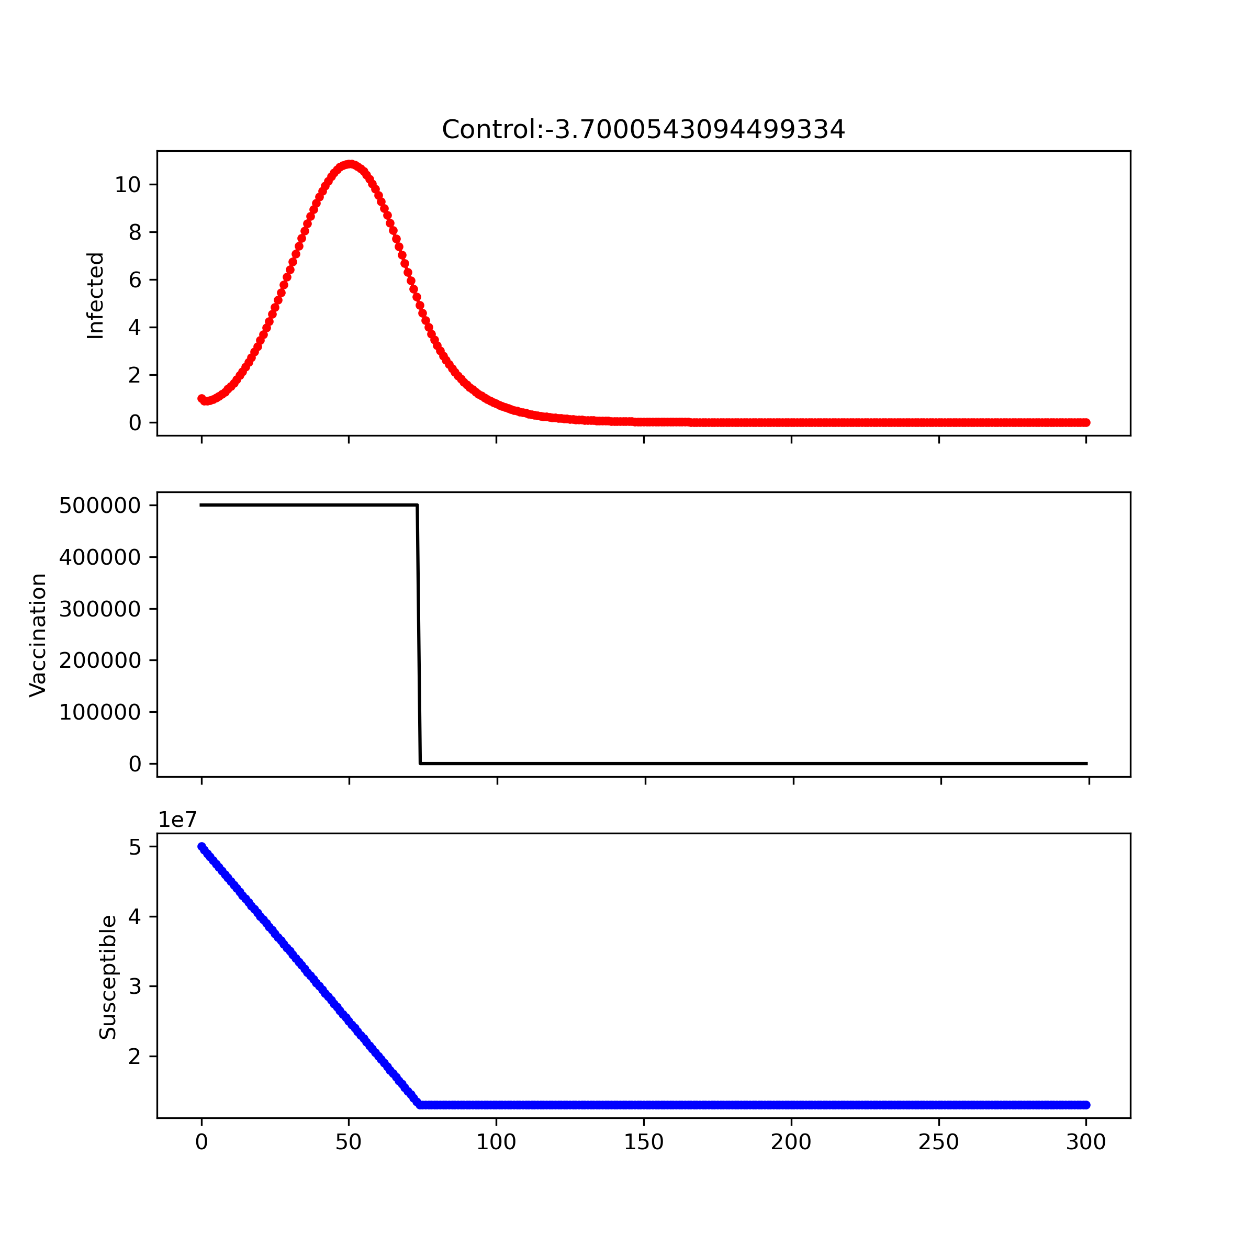
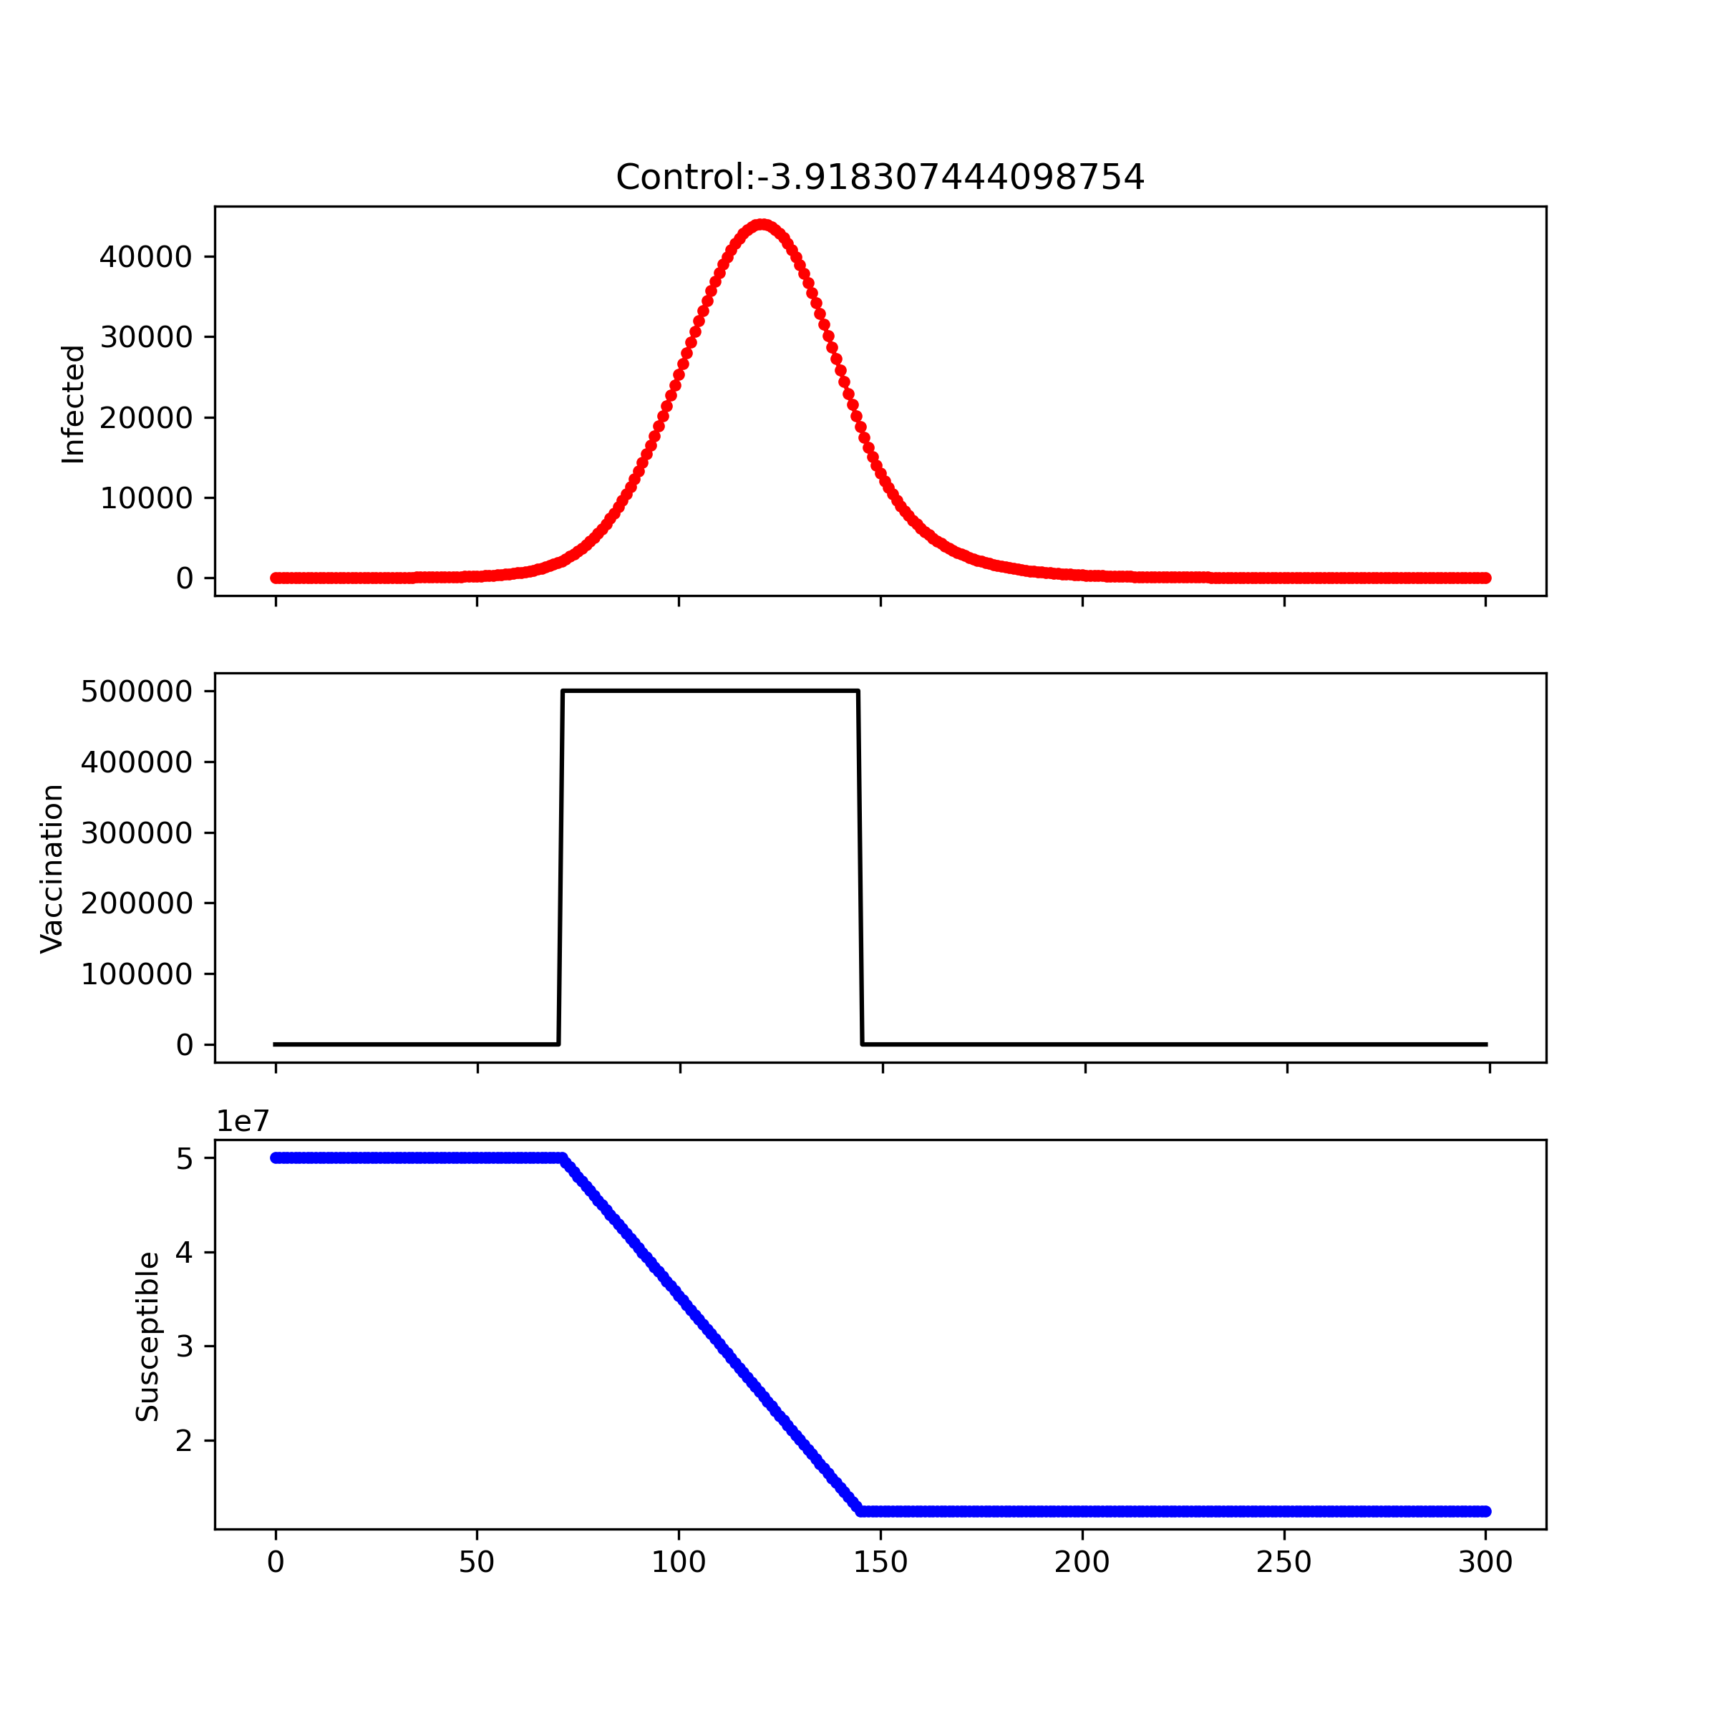
Control shifting
maximum check
Control shifting

Slide 7
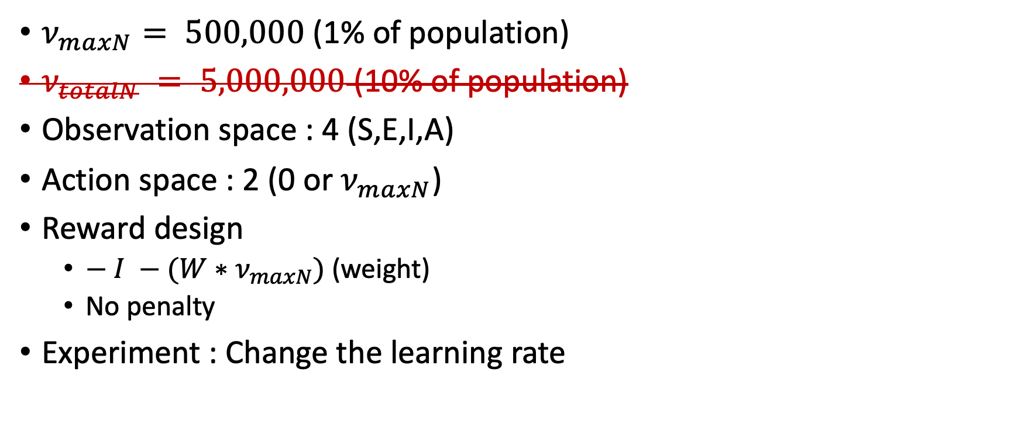
Experiment1
$ν_{maxN}⁡= 500,000$ (1% of population)
$ν_{totalN} = 5,000,000$ (10% of population)
Observation space : 4 (S,E,I,A)
Action space : 2 (0 or$ν_{maxN}$)
Reward design
$− I −{(W∗ν}_{maxN})$(weight)
No penalty
Experiment : Change the learning rate

Slide 8
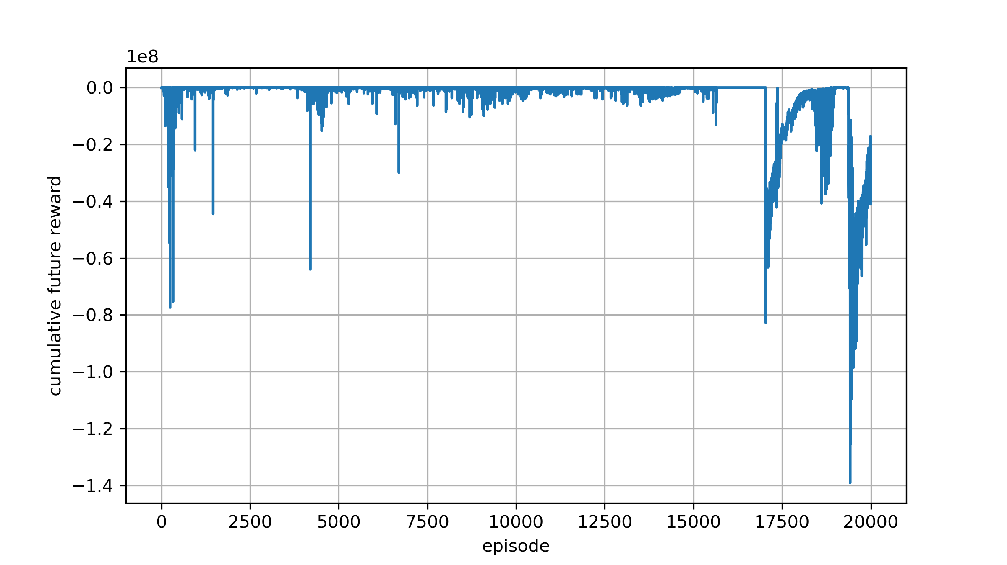

Experiment1 : no penalty
Learning rate : 1e-4 Reward design : $−I−(ν_{N}/1e7)$

Slide 9
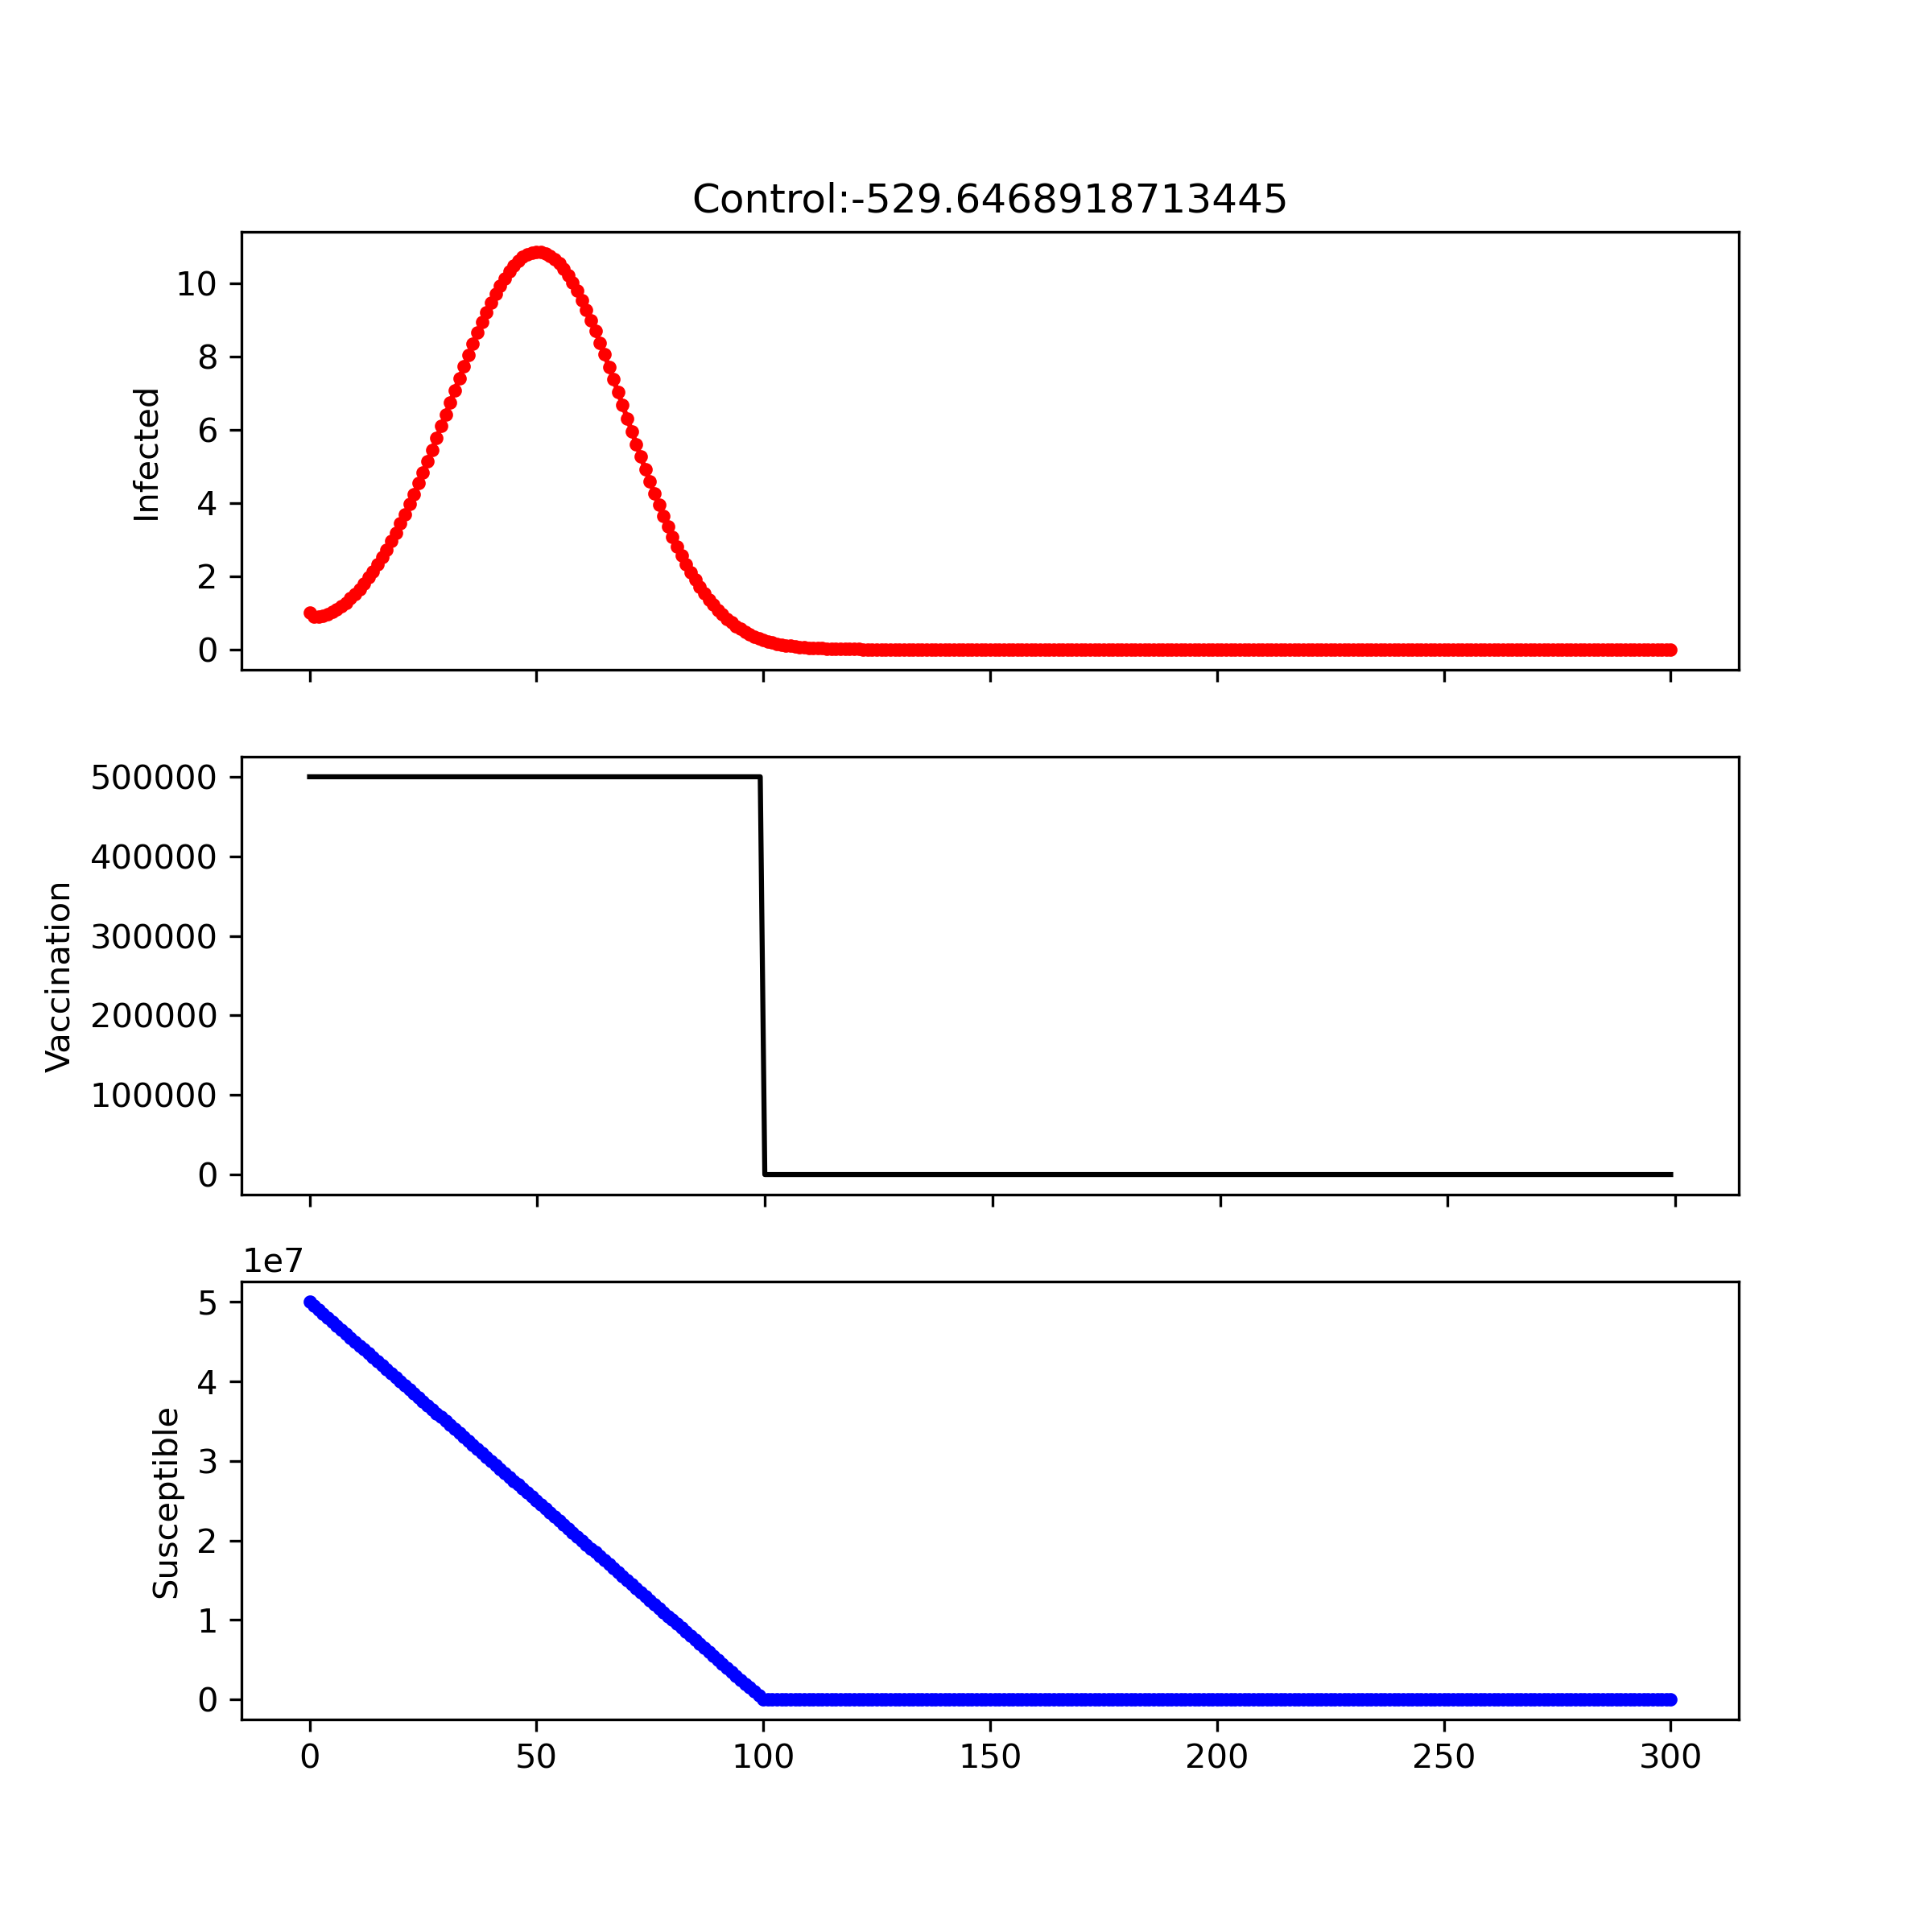
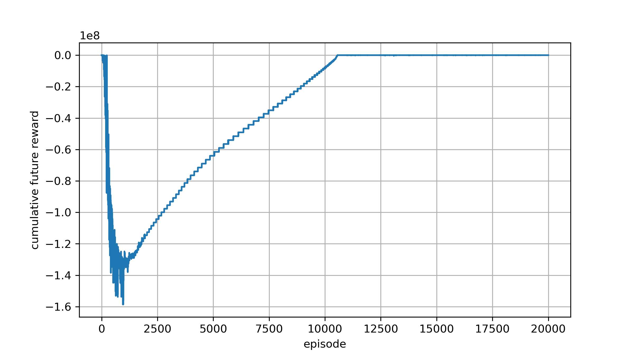

Learning rate : 1e-6 Reward design : $−I−(ν_{N}/1e7)$
Experiment1 : no penalty

Slide 10



Experiment1 : no penalty
Learning rate : 1e-6 Reward design : $−I−(ν_{N}/1e5)$

Slide 11
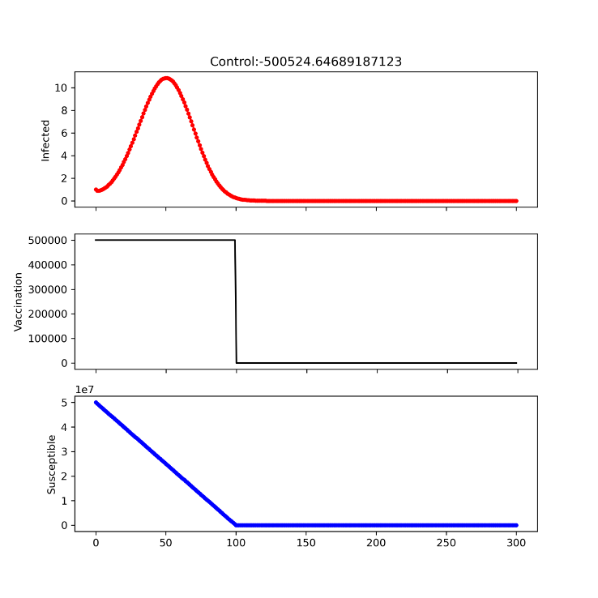
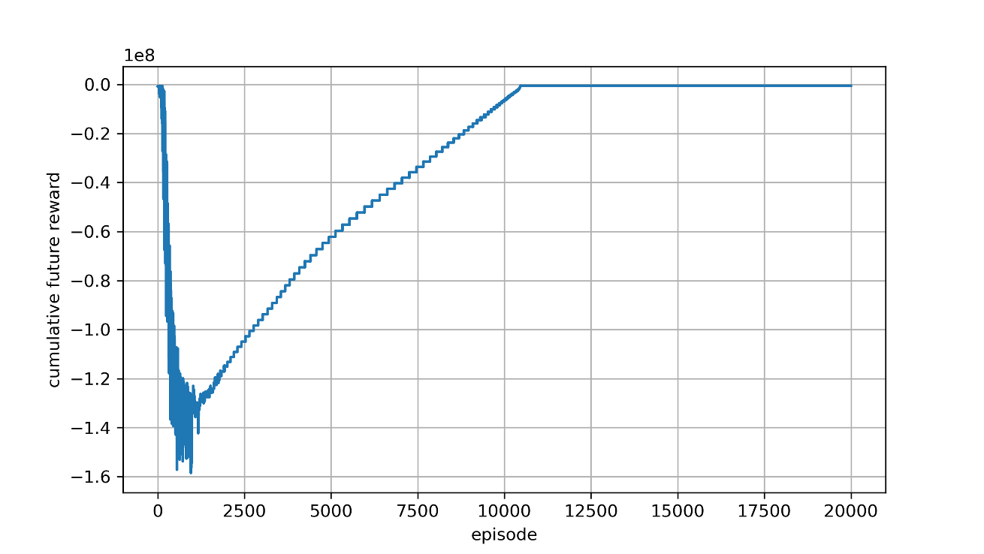

Experiment1 : no penalty
Learning rate : 1e-6 Reward design : $−I−(ν_{N}/1e2)$

Slide 12
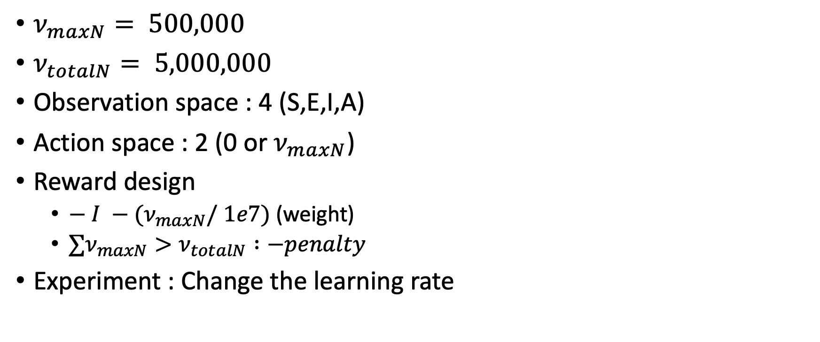
Experiment2
$ν_{maxN}⁡= 500,000$
$ν_{totalN}⁡= 5,000,000$
Observation space : 4 (S,E,I,A)
Action space : 2 (0 or${ ν}_{maxN}$)
Reward design
$− I −{(ν}_{maxN}/ 1e7)$(weight)
$∑ν_{maxN}>ν_{totalN} :−penalty$
Experiment : Change the learning rate

Slide 13

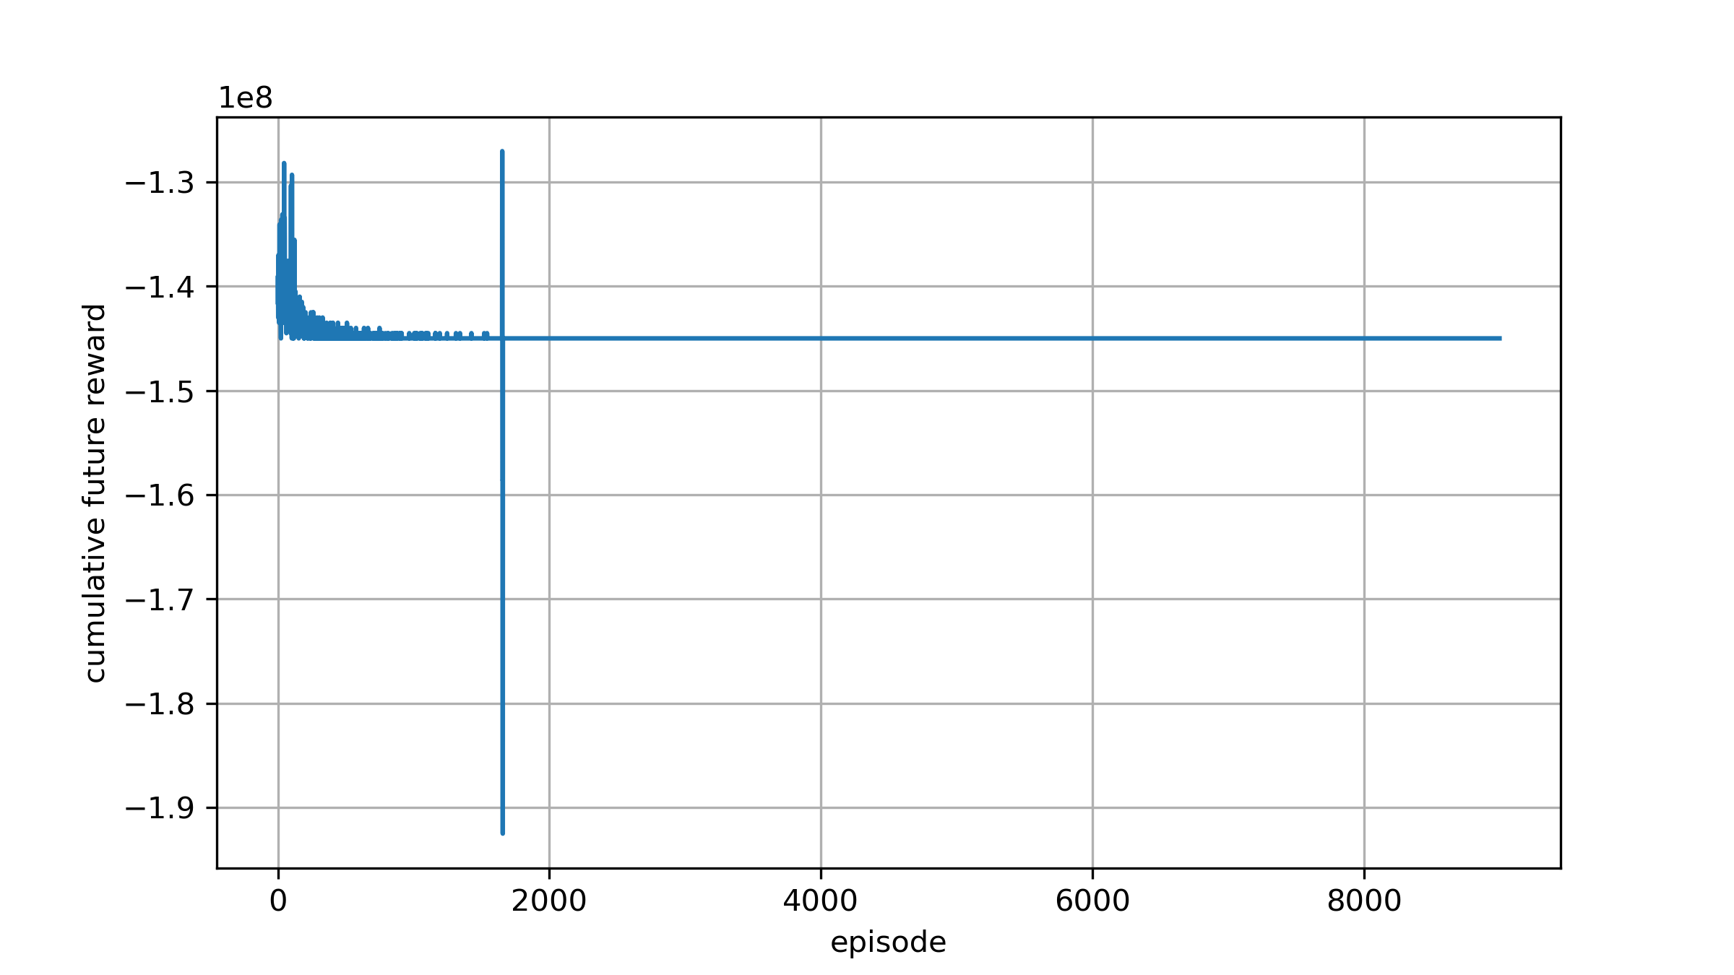
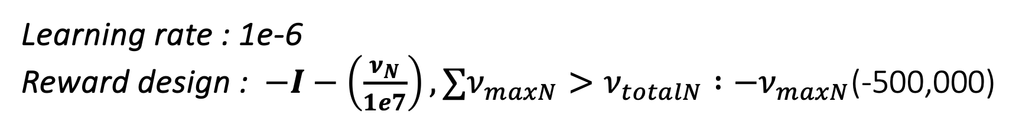

Experiment2
Learning rate : 1e-6 Reward design : $−I−\left(\frac{ν_{N}}{1e7}\right), ∑ν_{maxN}>ν_{totalN} :−ν_{maxN}$(-500,000)
$$5e6 ∗ 290 = 145e6$$

Slide 14
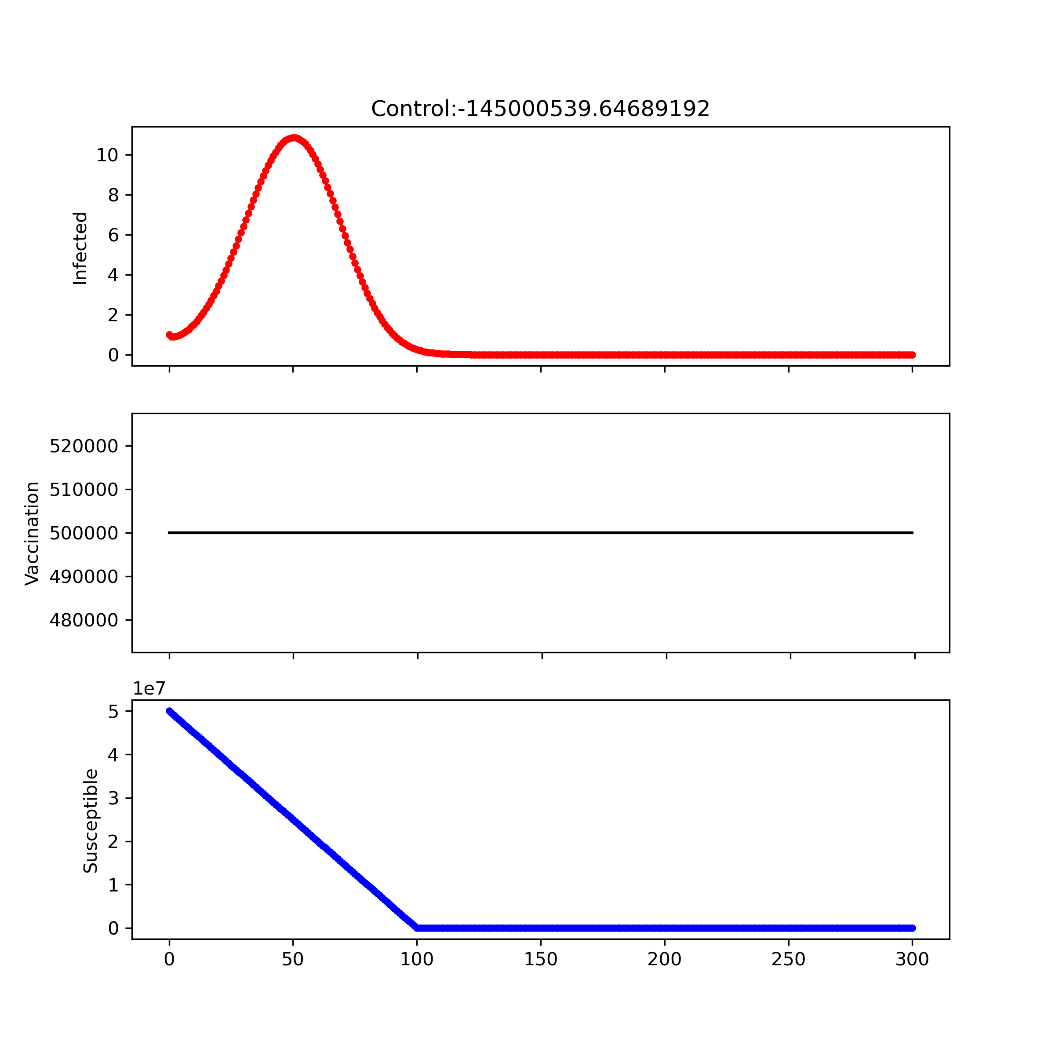
Experiment2
Learning rate : 1e-6 Reward design : $−I−\left(\frac{ν_{N}}{1e7}\right), ∑ν_{maxN}>ν_{totalN} :−ν_{maxN}$(-500,000)
$$5e6 ∗ 290 = 145e6$$

Slide 15

Experiment2
Learning rate : 1e-6 Reward design : $−I−\left(\frac{ν_{N}}{1e7}\right), ∑ν_{maxN}>ν_{totalN} :−ν_{maxN}$(-500,000)
$$5e6 ∗ 290 = 145e6$$

Slide 16
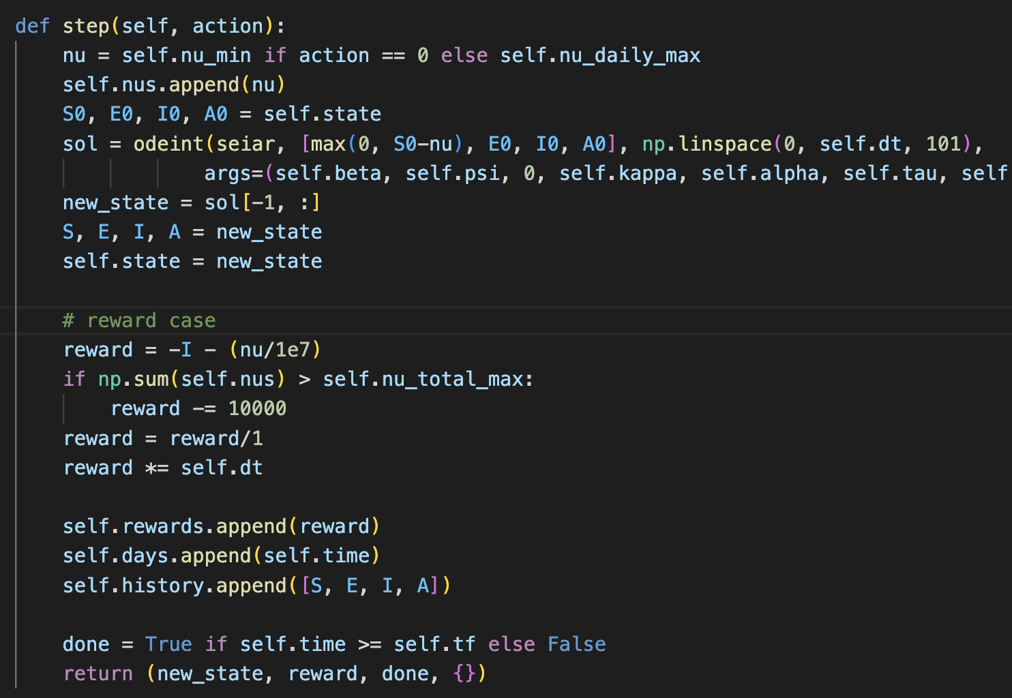

Debugging point
$$5e6 ∗ 290 = 145e6$$
Vaccination은 90일 초과 하였으나, reward가 290일치 penalty 받은 결과
Step 단위로 작동
이전 step에 penalty 받은 부분이 계속 누적

Slide 17
Todo for SEIAR
Debugging for penalty term operation
Find the proper penalty design

